Slide 1
Knowledge Graph Methods

Slide 2
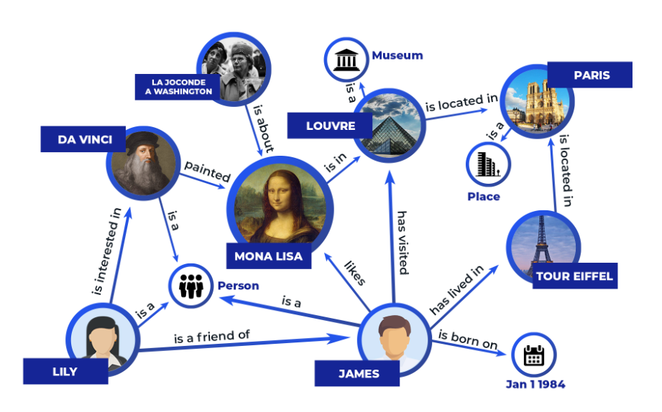
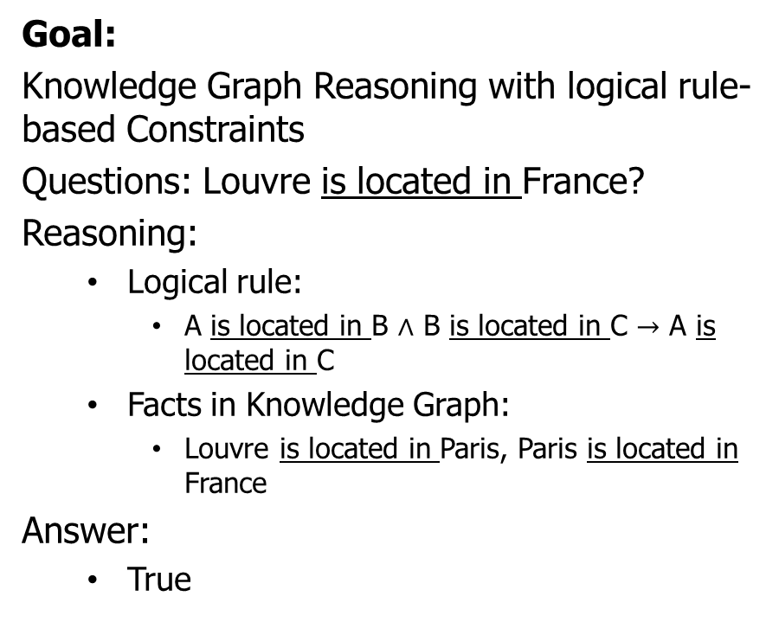
Knowledge Graph Reasoning
Goal:
Knowledge Graph Reasoning with logical rule-based Constraints
Questions: Louvre is located in France?
Reasoning:
Logical rule:
A is located in B $∧$ B is located in C $→$ A is located in C
Facts in Knowledge Graph:
Louvre is located in Paris, Paris is located in France
Answer:
True

Slide 3
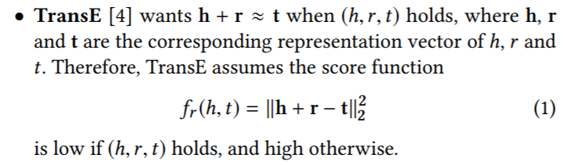
Existing Methods
Knowledge graph embedding
Basic Idea: Learn low dimension vectors for each entities and relations to capture the similarity of entities.
Representative method: TransE

Slide 4
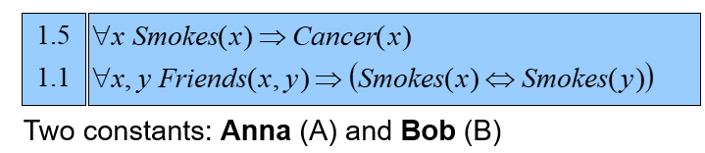
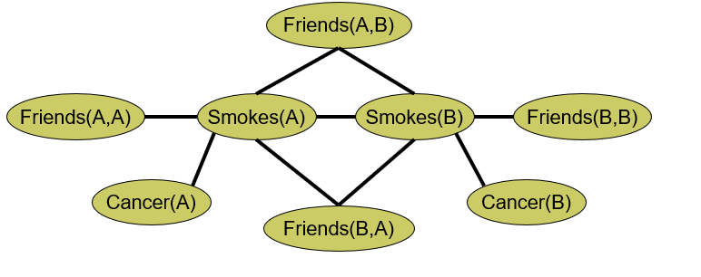
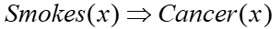
Existing Methods
Markov Logic Network
Given
A collection of facts
E.g., Friends (Anna, Bob), Smokes(Anna)
A set of first order logic rules with weight
E.g., 0.9
Infer
Whether an unobserved fact holds true
E.g., Cancer(Bob)?

Slide 5
Combining two worlds
Designing logic rule-based regularization to embedding models
E.g., KALE, Jointly Embedding Knowledge Graphs and Logical Rules (EMNLP’16)
Designing embedding-based variational distribution for variational inference of MLN
E.g., Probabilistic Logic Neural Networks for Reasoning (NeurIPS’19)
Our ongoing work: A Unified Framework for Combining Embedding and Horn Rules for Knowledge Graph Inference
Achieve better efficiency and effectiveness than the existing work

Slide 6
Knowledge Graph Implementations

Slide 7
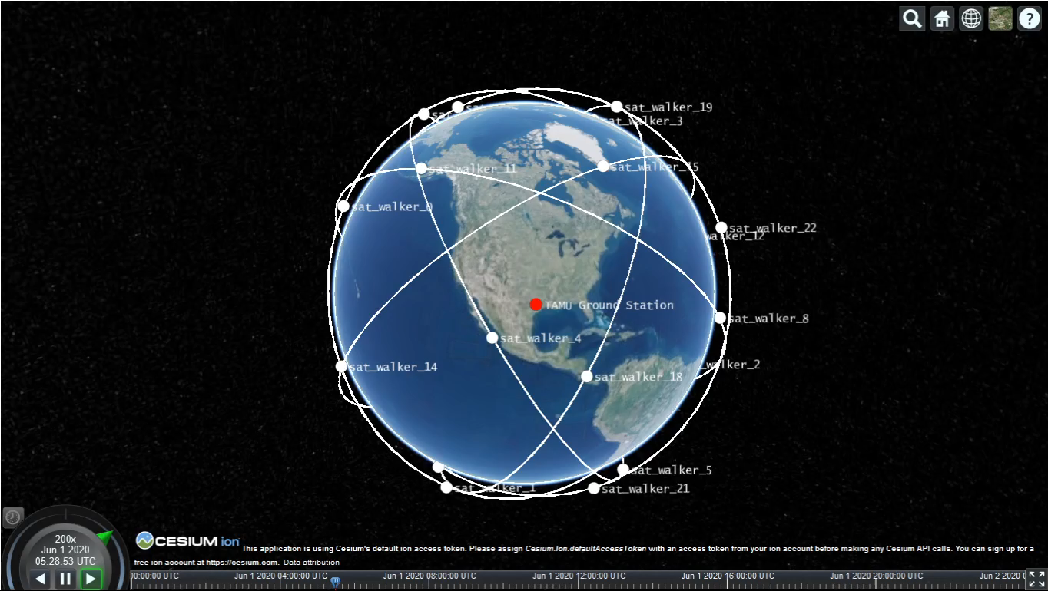
Work done so far
Worked on defining an Earth Observation example scenario
Mission is to provide measurements of a certain observable, e.g., launch detection with certain properties (e.g., accuracy, spatial resolution)
Various platforms (air, space, ground) have different kinds of sensors with complementary capabilities (e.g., microwave, infrared)
Platforms autonomously decide whether to join a mission or not based on
Knowledge Graph (global knowledge of physics, which sensors can measure what + local knowledge about this agent’s capabilities)
Mission specification
Worked on simulation framework for demo using Orekit + Cesium

Slide 8
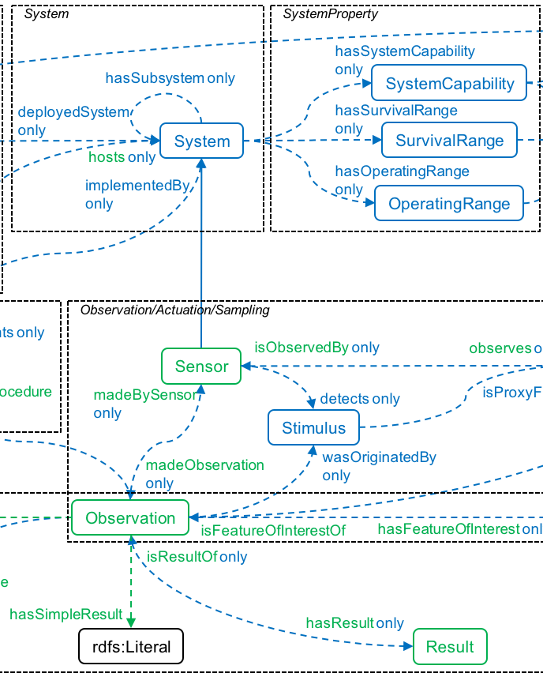
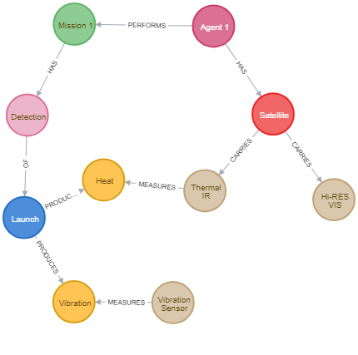
Work done so far
Researched potential ontologies to use in the KG (Semantic Sensor Network Ontology)
Researched KG development tools (chose Neo-4j over grakn) and developed example knowledge graph
Researched potential corpuses of data to mine to complete the KG (adafruit, CEOS database) and approaches for link prediction (embeddings)
Researched Markov Logic Networks as a means to incorporate uncertainty in the KG (prac-mln library)
SSN ontology
Example KG

Slide 9
Next Steps
Continue developing KG including automatic graph completion from existing corpuses
Continue developing Orekit+Cesium simulation framework
Generate MLN program from the KG and the problem formulation
Explore connections with Markov Decision Processes and temporal logics (PLTL/PCTL) with Cornell team
Compare pure MLN approach to planning-based approach

Slide 10
Specification

Slide 11
Specification
Agent 1
(a₁)
Agent 2
(a₂)
Goal:
Generate temporal specifications over a knowledge graph
Sensor 1
(s₁)
Sensor 2
(s₂)
Sensor 3
(s₃)
P₁
P₂
Measurement 1
(m₁)
Measurement 2
(m₂)
P₃

Slide 12
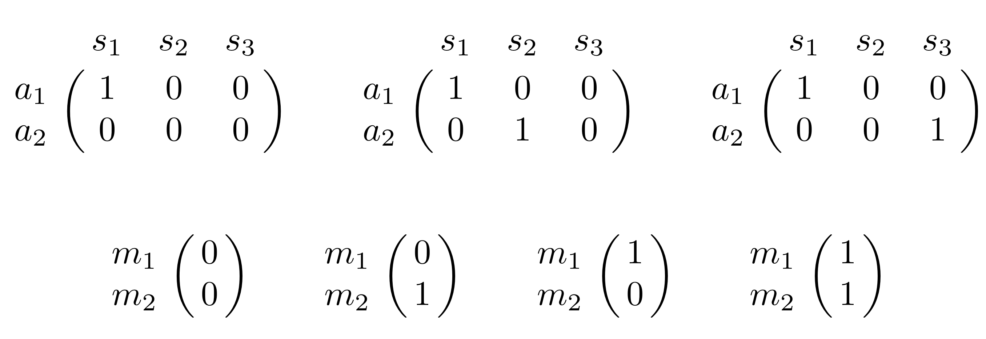
(Portion of) MDP
actions
a₁
a₂
p₁
(1-p₁)(1-p₂)
s₁
s₂
s₃
TO_A1S1_A1S2
TO_A1S1
P₁
P₂
TO_A1S1_A1S2
(1-p₁)p₂
m₁
m₂
P₃
TO_A1S1_A2S3
p₁p₃
Knowledge Graph
TO_A1S1_A1S2
p₁p₂
1-p₁
TO_A1S1
p₁(1-p₂)
TO_A1S1_A1S2

Slide 13
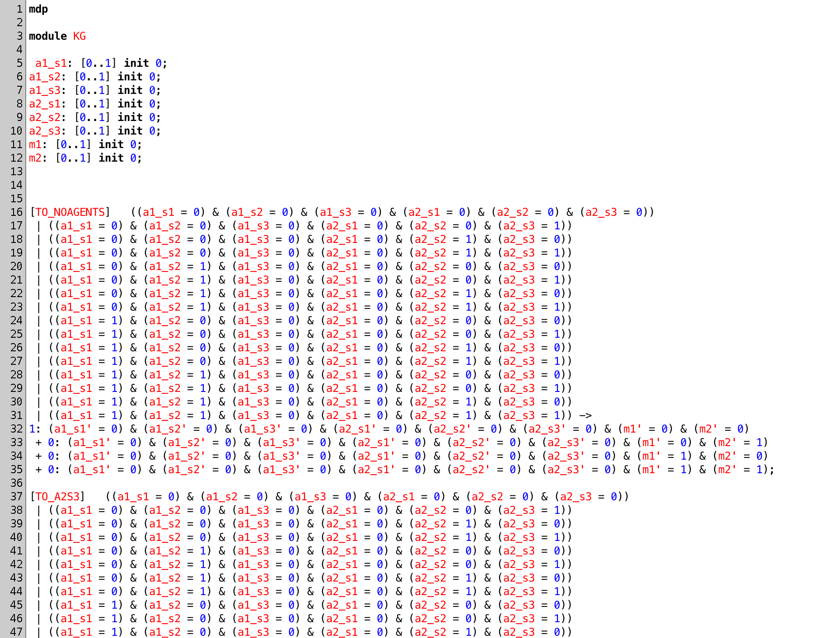
PRISM Simulation
PRISM: probabilistic model checker
actions
probabilities of next states

Slide 14
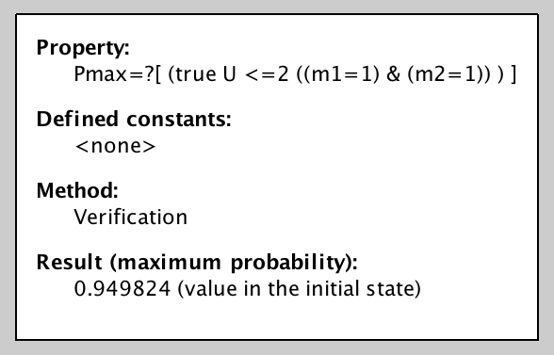
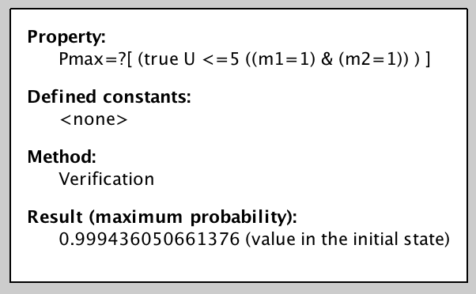
Mission Specification
Probabilistic Computation Tree Logic (PCTL)
Current specification is a “bounded always”
Next step: generate more complex MDPs and specifications

Slide 15
Local planning and state estimation

Slide 16
Work done so far
Survey of state estimation methods: Bayes filter, particle filter, Kalman Filter
Survey of data fusion methods: Covariance Intersection KF, Multi-Bayes estimation, fuzzy logic, DNN.
Goal: Based on Knowledge Graph and capability reasoning, decide what is needed for state estimation and how to correlate those variables to autonomously generate the decentralized data fusion algorithm.

Slide 17
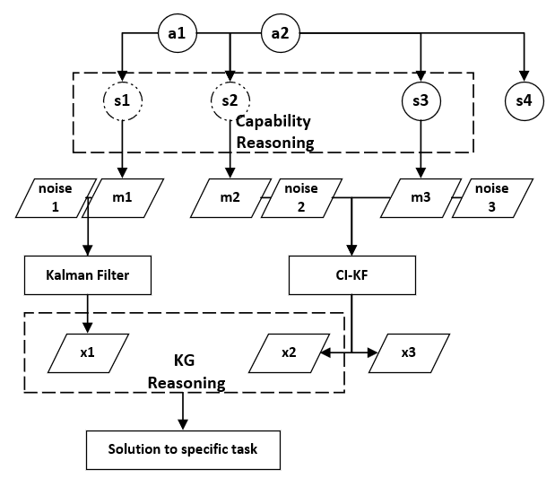
Workflow
Goal:
To autonomously create a Kalman Filter framework which could estimate the desired state from sensors, deriving context from KG, MLN.

Slide 18
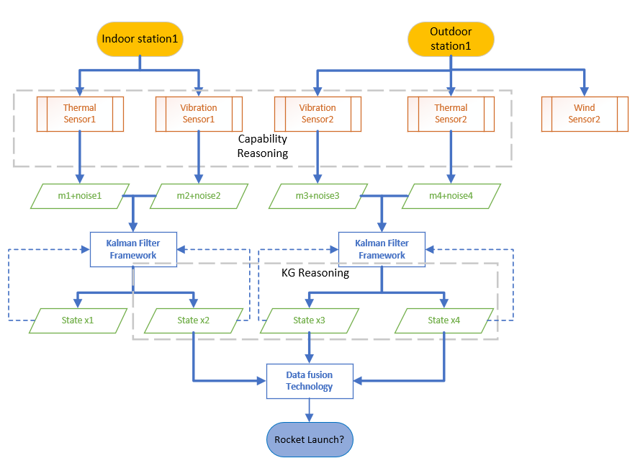
Example
Capability reasoning would determine whether a sensor has the ability of joining this mission and give out its measurement along with noise.
KG reasoning can determine if the output from KF framework is really helpful to our mission.

Slide 19
KF Framework
Advantages:
Near-optimal estimation accuracy
Computation and storage efficiency
Online / recursive math for scalability
Intrinsic measures of cost / performance
Next step:
Specify what variables will be needed to feed into KF framework from capability reasoning.
Determine data fusion process in KF framework.

